Slide 1

ENDPOINT & APPLICATION DEVELOPMENT SECURITY
Network and Security (INFO8965)
Pawan Soobhri
Professor
MISSM, PGDBM, BTech
Email: psoobhri@conestogac.on.ca

Slide 2
REFERENCES AND ACKNOWLEDGEMENT
References
[CIAM] “CompTIA® Security+ Guide to Network Security Fundamentals” by Mark Ciampa, 7th edition, Publisher: Cengage Learning
[STAL] “Network Security Essentials,” by William Stallings, 5th edition, Publisher: Pearson
Acknowledgement
Some of the material presented here is taken from:
    The referenced textbook [CIAM] by Cengage Learning.
    Other references are cited individually.

Slide 3
LECTURE LAYOUT
Threat Intelligence Sources Securing endpoints
Create and deploy SecDevOps

Slide 4
THREAT INTELLIGENCE SOURCES
Organizations share resources and knowledge about the latest cyber-attacks with the broader security community.
Key risk indicators (KRIs) are metrics that define the upper and lower bounds of normal network activity.
Example: total network logs per second (A sudden spike might indicate unusual activity), number of failed remote logins (Multiple login failures might suggest a brute-force attack), etc.
A KRI exceeding its normal bounds could be an indicator of compromise (IOC)
An IOC shows that a malicious activity is occurring but is still in the early stages of an attack

Slide 5
THREAT INTELLIGENCE SOURCES
Threat intelligence sources: Open-source vs closed source
Open-source threat intelligence information is often called open-source intelligence (OSINT) – publicly available and legally accessible (https://osintframework.com/)
OSINT framework focused on gathering information from free tools or resources
Privacy: an organization that is the victim of an attack must be careful not to share proprietary or sensitive information when providing IOCs and attack details
Tools: Structured Threat Information Expression (STIX), Trusted Automated Exchange of Intelligence Information (TAXII)

Slide 6
THREAT INTELLIGENCE SOURCES
Sources of threat intelligence that are useful:
          Vulnerability database
                https://www.cve.org/
                https://nvd.nist.gov/
Threat maps
https://threatmap.checkpoint.com/
https://livethreatmap.radware.com/
File and code repositories
https://bazaar.abuse.ch/
https://www.virustotal.com/
https://app.any.run/
Dark web
https://www.youtube.com/watch?v=H7-pJiC-N-g

Slide 7
KNOWLEDGE CHECK
What is the significance of a KRI (Key Risk Indicator) exceeding its normal bounds.
It must be referred to the DHS (Department of Homeland Security).
It could be an IOC (Indicator of Compromise).
It probably contains a TTP (Tactics, Techniques, and Procedures).
An AIS (Automated Indicator Sharing) should be generated.

Slide 8
KNOWLEDGE CHECK
What does an Indicator of Compromise (IOC) signify.
A successful software update
Evidence that a system or network has been breached
A routine network maintenance activity
A type of encryption algorithm

Slide 9
SECURING ENDPOINTS
Securing endpoint computers primarily involves three major tasks:
Confirming that the computer has started securely
Protecting the computer from attacks
Hardening it for even greater protection

Slide 10
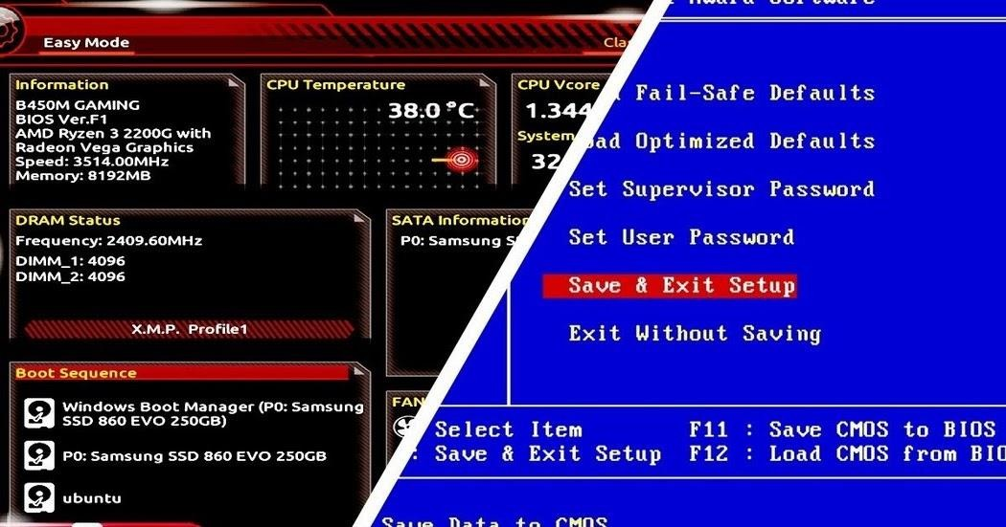
SECURING ENDPOINTS (CONFIRM BOOT INTEGRITY)
Ensuring secure startup involves the Unified Extensible Firmware Interface (UEFI) and its boot security features
UEFI replaced the older BIOS (Basic Input/Output) firmware interface and offers many advantages
The ability to update the BIOS introduce risk of BIOS attacks.
This Photo by Author is licensed under CC BY-SA-NC
Boot security focuses on validating each step of the boot process to ensure no modifications have been made, starting with the boot software and continuing through to the operating system.
This process, known as the “chain of trust,” relies on hardware as the strongest starting point, as it cannot be modified like software (referred to as hardware root of trust).

Slide 11
SECURING ENDPOINTS (PROTECTING ENDPOINT)
Antivirus software can examine a computer for file-based virus infections and monitor computer activity
Antimalware is a suite of software intended to provide protections against multiple types of malware
Web browser protections offer security features like secure cookies are sent to a web server with an encrypted request over the secure HTTPS protocol
Prevents unauthorized interception of a cookie being transmitted
Monitoring and response systems
Host Intrusion Detection Systems (HIDS) is a software-based application that runs on an endpoint computer and can detect an attack has occurred
Host Intrusion Prevention Systems (HIPS) monitor endpoint activity to immediately block a malicious attack by following specific rules
Endpoint Detection and Response (EDR) tools are considered more robust than HIDS and HIPS. Aggregate data from multiple endpoints.

Slide 12
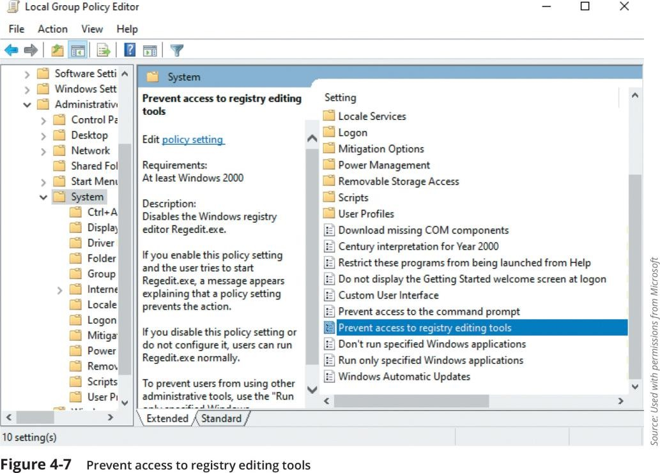
SECURING ENDPOINTS (HARDENING ENDPOINT)
Hardening endpoints involves patch management and OS protections
Patch management is the process of identifying, acquiring, testing, deploying, and verifying software updates, known as patches, to fix vulnerabilities
OS protections:
Disable unnecessary ports and services. Disable default accounts/passwords
Windows 11 Tamper Protection security feature prevents Windows security settings from being changed or disabled by a threat actor who modifies the registry
Application whitelisting/blacklisting: Pre-approve or block specific applications
Sandboxing: Isolate applications in a controlled environment
Quarantine: Move malware to a quarantine area

Slide 13
KNOWLEDGE CHECK
Which of the following is NOT a tool that can be used to confine or restrict malware?
a. Whitelisting
b. Quarantine
c. Sandbox
d. Legacy boot

Slide 14
CREATING AND DEPLOYING SECDEVOPS
An unsecure application can open the door for attackers to exploit the application, the data that it uses, and even the underlying OS
SecDevOps is the process of integrating secure development best practices and methodologies into application software development and deployment processes, such as agile model

Slide 15
CREATING AND DEPLOYING SECDEVOPS
Secure development practices
Regular code reviews
Static application security testing (SAST) – Tools: SonarQube, Checkmarx, Fortify
Dynamic application security testing (DAST) – Tools: OWASP ZAP, Burp Suite
Continuous Integration and Continuous Deployment (CI/CD)
Automated testing – Tools: Jenkins, GitLab CI
Infrastructure as Code (IaC) – Tools: Terraform, Ansible

Slide 16
CREATING AND DEPLOYING SECDEVOPS
Monitoring and Logging
Real-time monitoring – Tools: Prometheus, Grafana
Log management – Identify suspicious activities and potential threats
Security Training and Awareness
Training Programs for developers and operations teams.
Designate Security Champions

Slide 17
KNOWLEDGE CHECK
Which of the following best describes static code analysis?
Testing uses a suite of pre-built attacks.
Tests are run before the source code is compiled.
Random input is used to trigger exceptions.
Used after all components are integrated.

Slide 18
Questions?

